Slide 1
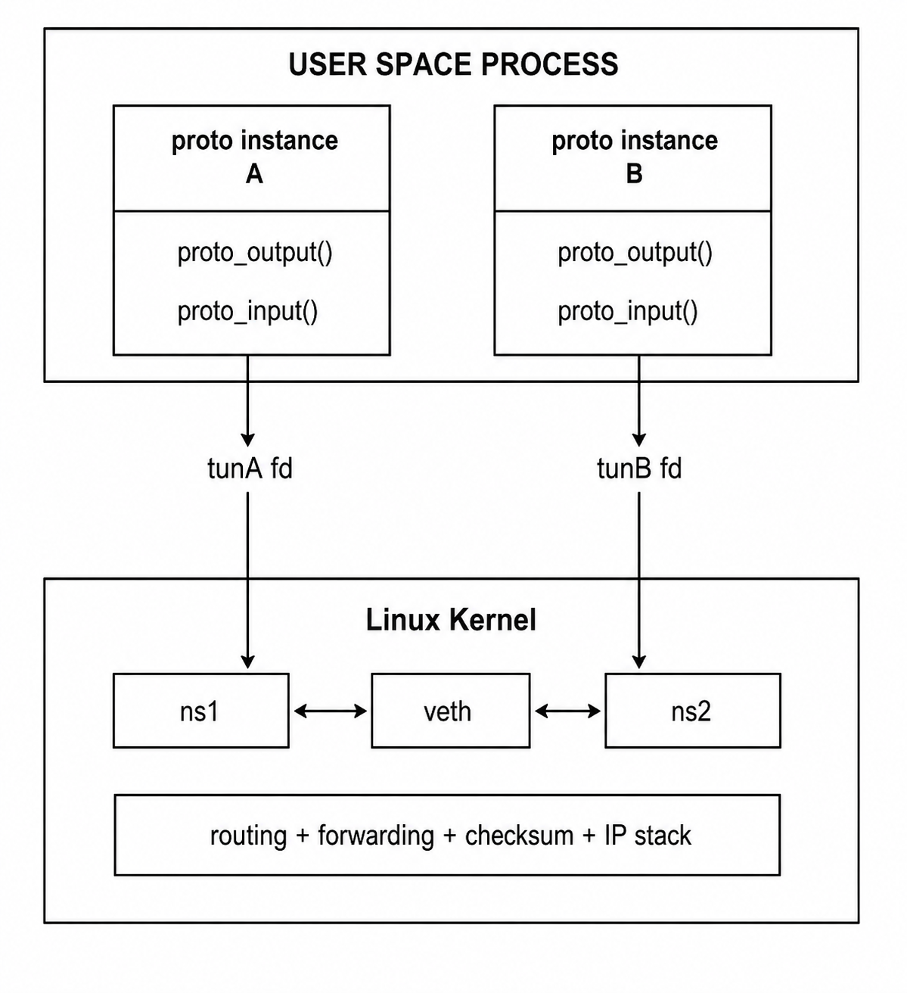
V4 (tun_ns_test.c)
Process A → tun0 → kernel(ns1) → veth → kernel(ns2) → tun1 → Process B

Slide 2
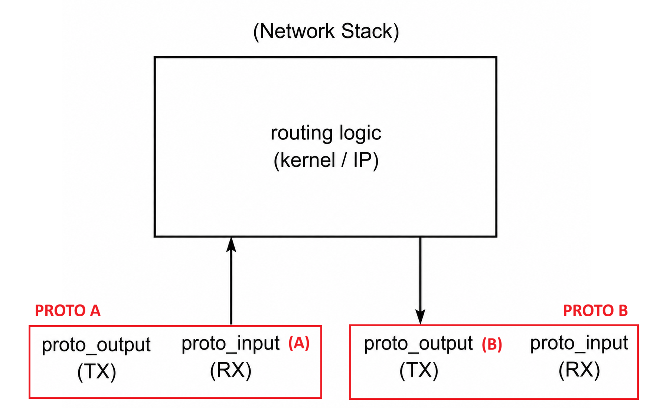
V4 (tun_ns_test.c)
Process A → tun0 → kernel(ns1) → veth → kernel(ns2) → tun1 → Process B
proto_input(tun write) proto_ouput(tun read)
No direct path proto_input(A) -> proto_output(A)
No direct path proto_output(A) -> proto_input(B)

Slide 3
V4 (tun_ns_test.c)
Emulation of the boundary between protocol driver <--> network stack
TX and RX are fully separated into independent processes
The working example uses two separate namespaces : ns1 (tun0, veth0) and ns2 (tun1, veth1)
Each namespace owns exactly one TUN interface
A TUN device gives you:
packet injection into kernel
packet extraction from kernel
Routing causes packets written on one TUN to cross the kernel network stack and come out on the other namespace’s TUN
One process writes to tun0; another process reads from tun1
Linux transports packets between namespaces
Emulates a routed topology using: separate namespaces, veth transport, explicit next-hop routes separate TX/RX processes
NOTE: a TUN interface it is a userspace endpoint attached to the kernel IP stack (userspace <-> kernel IP stack), and not a pipe between processes (userspace <-> userspace) so without a veth pair (or some other L2/L3 transport path), Linux has no physical/logical path between namespaces.

Slide 4
V4 (tun_ns_test.c) – VETH
veth is now ONLY infrastructure transport for this demo (not the same as production routing)
The namespaces + veth pair create a true forwarding path.
in production we'll have legacy protocol transport (raw IP / UDP) + legacy routing tables

Slide 5
V4 (tun_ns_test.c)
Process A → tun0 → kernel(ns1) → veth → kernel(ns2) → tun1 → Process B
ns1: ns2: tun0 10.0.0.1 tun1 10.0.1.1 veth0 192.168.0.1 veth1 192.168.0.2
proto_input(A) -> write(tunA) -> Linux kernel IP stack -> routing/veth/ns forwarding -> packet appears on tunB -> proto_output(B)
Data path :
User-space injects packets via TUN (into tun0) Kernel performs routing/forwarding Another user-space endpoint receives packet vis TUN (from tun1) Payload validated

Slide 6
RUN V4 (tun_ns_test.c)
Namespace setup: create namespaces, create veth pair, move veth into namespaces, and configures ns1/ns2
sudo bash setup_netns.sh
Terminal 1 (receiver)
sudo ip netns exec ns2 ./proto_kernel_test B
Terminal 2 (sender)
sudo ip netns exec ns1 ./proto_kernel_test A
Receiver Output
RX: waiting... RX: got packet len=24 payload: TEST TEST PASSED
Sender Output
TX: sending packet TX done

Slide 7
V4 (tun_ns_test.c) PACKET FLOW
Process A → tun0 → kernel(ns1) → veth → kernel(ns2) → tun1 → Process B
ns1: ns2: tun0 10.0.0.1 tun1 10.0.1.1 veth0 192.168.0.1 veth1 192.168.0.2
The key TUN points:
Writing to a TUN device injects a packet INTO the kernel IP stack.
Reading from a TUN device receives packets the kernel routed TO that interface.
ip->protocol = IPPROTO_ICMP;
Each instance = node, and each node has an IP 10.0.0.99 (src) → 10.0.1.99 (dst)
-> write(tun0) -> kernel injects packet into ns1 stack -> routing : 10.0.1.0/24 via 192.168.0.2 dev veth0 -> packet exits via veth0 -> crosses veth pair -> arrives ns2 via veth1 -> routing in ns2 says packet belongs to tun1 subnet -> kernel delivers packet to tun1 -> read(tun1)

Slide 8
V5 (proto_kernel_test.c) same as V4
The working example uses two separate namespaces : ns1 (tun0, veth0) and ns2 (tun1, veth1)
Each namespace owns exactly one TUN interface
A TUN device gives you:
packet injection into kernel
packet extraction from kernel
Routing causes packets written on one TUN to cross the kernel network stack and come out on the other namespace’s TUN
One process writes to tun0; another process reads from tun1
Linux transports packets between namespaces
TX and RX are fully separated into independent processes
Emulates a routed topology using: separate namespaces, veth transport, explicit next-hop routes separate TX/RX processes
NOTE: a TUN interface it is a userspace endpoint attached to the kernel IP stack (userspace <-> kernel IP stack), and not a pipe between processes (userspace <-> userspace) so without a veth pair (or some other L2/L3 transport path), Linux has no physical/logical path between namespaces.

Slide 9
V5 (proto_kernel_test.c) – Closer mapping Legacy → Linux user-space
Legacy | New
proto_output(ifp, m, dst, rt) | proto_output(instance, mbuf)
proto_input(ifp, m) | proto_input(instance, mbuf)
mbuf | simple mbuf struct
ifnet | simple struct with tun fd
BSD/LynxOS routing + routing table (rtentry structure) | Linux kernel routing

Slide 10
V5 (proto_kernel_test.c) versus Legacy
Removed:
Routing table (rtentry structure) → Linux kernel handles routing in the test!
Semaphores → single-threaded process in
Hardware interrupts → process become data driven in user space
Data driven execution
Preserve
Ifnet and mbuf structures
Multiple protocol instances (scalable)
Protocol driver instance and function signatures and semantics (proto_output() / proto_input())
proto_input() → injects into TUN
proto_output() → reads from TUN
Production Implementation
User space routing control plane + Routing tables (user-space daemon):
computes routes
installs routes into kernel
kernel forwards packets

Slide 11
RUN V5 (proto_kernel_test.c)
Namespace setup:
sudo bash setup_netns.sh
Terminal 1 (receiver)
sudo ip netns exec ns2 ./proto_kernel_test B
Terminal 2 (sender)
sudo ip netns exec ns1 ./proto_kernel_test A
Output
[INSTANCE_B] proto_input: len=24 src=10.0.0.99 dst=10.0.1.99 [INSTANCE_B] payload: TEST [INSTANCE_B] TEST PASSED

Slide 12
Production Implementation: LAYERS vs Harnesses
Harness 1 (TUN+transport)
Layer 1 (boundary between user space and Linux IP stack) and
Layer2 (IP packet handling + packet encapsulation)
Harness 2 (capture+replay) for Layer 3 + framing + compression + …
Layer 1 — Local virtual interface: TUN device to inject/extract IP packets: tun read, tun write
Layer 2 —Transport (inter-host E2E comm): preserve the packet semantics and encapsulation behaviour → IPv4 based, same semantics as UDP sockets or raw IP sockets from legacy:
IP headers, fragmentation, checksums, multicast, TCP/UDP classification
UDP-based for data transport: AF_INET + SOCK_DGRAM (UDP)
raw IP encapsulation for protocols like ICMP: SOCK_RAW + IPPROTO_ICMP
Layer 3 — Routing (network layer) = Linux kernel routing tables→ external to the protocol driver
Layer 4 — flows/subflows/QoS protocol (somewhere between OSI L3 and L4)
intercepts IP packets, manages flows classification, scheduling of QoS/subflows, packet replay, stats, compression, …

Slide 13
INTEROPERABILTY
LEGACY
legacy kernel protocol driver <-> BSD networking stack <-> custom routed transport
NEW IMPLEMENTATION
Linux userspace <-> TUN interface <-> Linux networking stack <-> same custom routed transport
INTEROPERABILITY (old PRODVR <--> new PRODVR)
Must preserve/use the same transport (wire protocol semantics and packet encapsulation) the old implementation already uses
Legacy transport is → IPv4-based (AF_INET) raw IP/UDP protocol, multicast
UDP-based for data transport: e.g. socket(AF_INET, SOCK_DGRAM, 0)
raw IP encapsulation for protocols like ICMP: e.g. socket(AF_INET, SOCK_RAW, IPPROTO_ICMP)

Slide 14
ROUTING IS ALMOST IDENTICAL
LEGACY - BSD/LynxOS routing
Legacy system already has a user-space routing control plane : routing_table.c
programming the OS routing table using:
BSD routing sockets
Solaris routing sockets
netlink on Linux
NEW IMPLEMENTATION - Linux kernel routing
routing_table_netlink_impl.c
This is the low-level interface to the routing table, intended for use only by the higher level interface in module routing_table.
This module encapsulates access to the host routing table, via the Linux Netlink sockets mechanism.
routing management using netlink:
NETLINK_ROUTE
rtnetlink

Slide 15
Legacy semantics
proto_output() = stack → driver egress callback
proto_input() = driver → stack ingress injection
routing is external to the driver
proto_input(B) -> inject packet into stack -> stack routes -> proto_output(A)

